Slide 1
Computer Architecture
A drive-by …

Slide 2
Fundamentals
Yes, you know what a computer is … but how well and at what level?
Understanding the basics of how things work relate to why we make certain architectural choices
Main components
  CPU
    Nuances:
      Clock speed -> sometimes critical
      Number of cores -> affects parallelism
      Instruction set (x86-64, ARM, RISC-V) -> compatibility & performance (high throughput vs complex instructions) & energy
        Apple M1 – progress, but Docker
  Memory
    What is available?
      Program design -> UX
        can we load a whole video to memory?
      JRE / DB / cache / etc tuning
Notes:
i.e. Traditional approach is spend weeks on requirements & theory of requirements; then spend weeks on arch and arch theory. We will take a more hands on approach.
Software architecture is rooted in computer architecture – the development of software architecture centers around how to make developing software easier and the process more robust.
Talk about definitions of CPU, Memory, etc.

Slide 3
Fundamentals
Yes, you know what a computer is … but how well and at what level?
Understanding the basics of how things work relate to why we make certain architectural choices
Main components
  Storage
    Types (HDD / SSD / NVMe / cloud / tape) -> cost / performance
    IOPS (input-output operations per second) -> bottleneck
    Reliability (RAID / distributed FS / redundancy)
    Cloud storage tiers -> coldness
  Bus
    Bandwidth -> bottleneck
    Latency -> performance
Notes:
i.e. Traditional approach is spend weeks on requirements & theory of requirements; then spend weeks on arch and arch theory. We will take a more hands on approach.
Software architecture is rooted in computer architecture – the development of software architecture centers around how to make developing software easier and the process more robust.
Talk about definitions of CPU, Memory, etc.

Slide 4
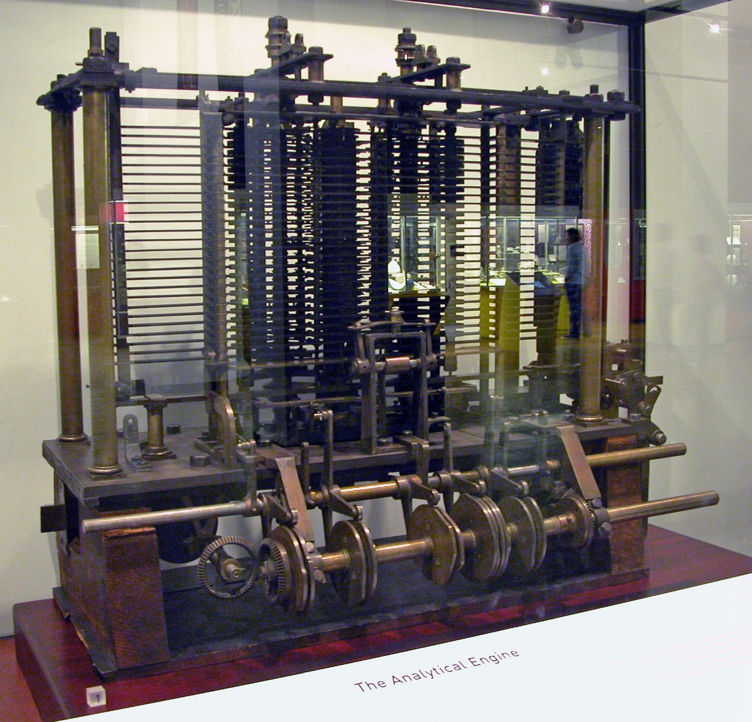
Where it began …
Charles Babbage and Ada Lovelace (circa 1800s)
Babbage devises his ‘analytic engine’. A mechanical computer with
  Arithmetic Control Unit – ALU in CPU
  Flow control, Branching – if … else
  Loops - for
  Memory…
Ada Lovelace - ideas which became a general
programming language for the analytic
engine. (Ever heard of the programming language ‘Ada’??)
All analog and mechanical; no electronic components!
Foundation of modern computers
By Bruno Barral (ByB), CC BY-SA 2.5, https://commons.wikimedia.org/w/index.php?curid=6839854

Slide 5
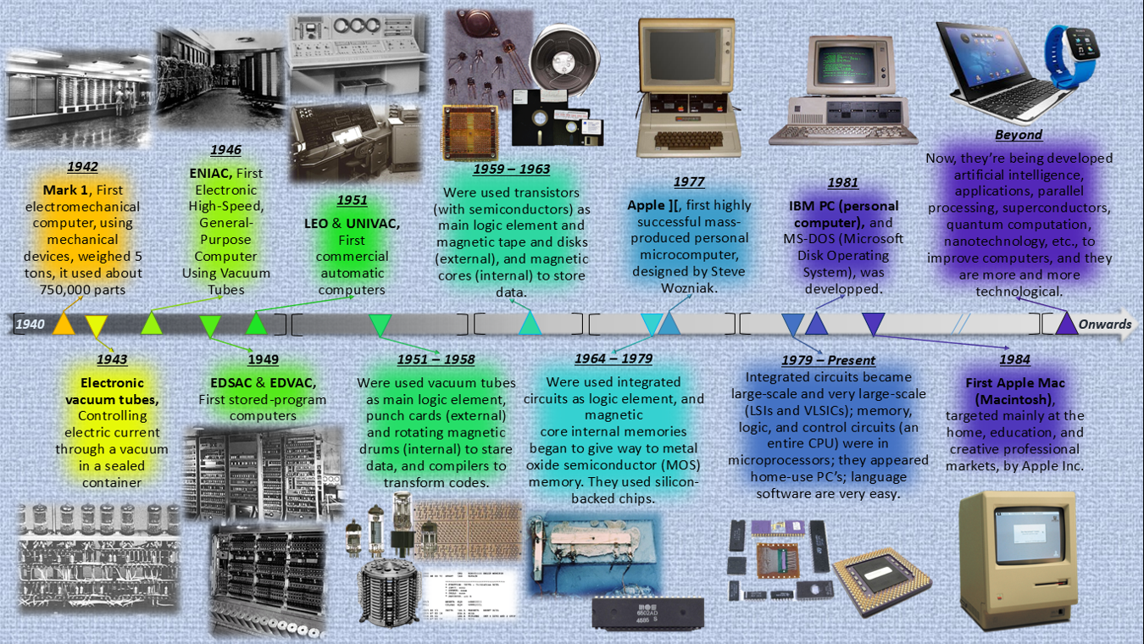
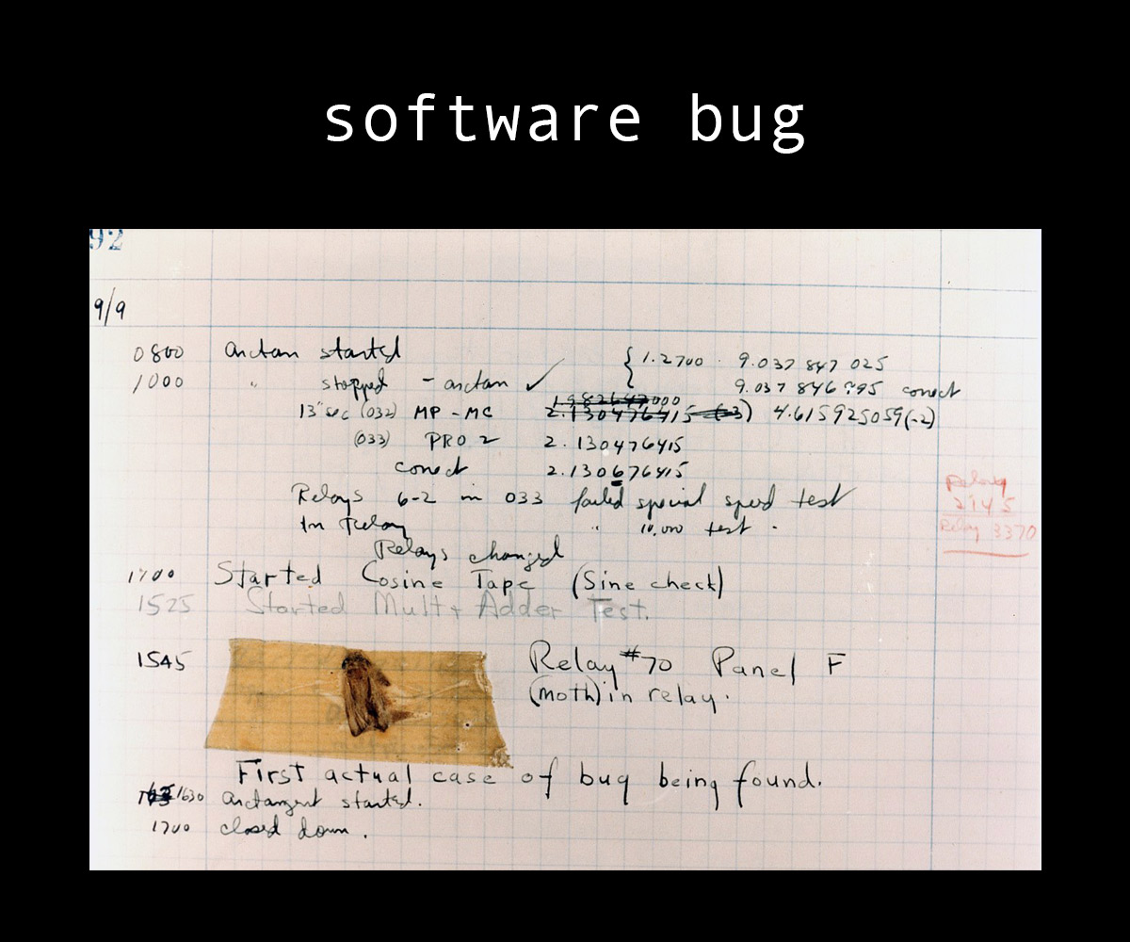
Ancestry.computer …
1942 – Mark 1 (electromechanical)
750,000 parts
5 tons
Very slow (mechanical parts)
1943 – electronic vacuum tubes
Instead of mechanical relays
Blazing fast (in comparison)

Slide 6
Ancestry.computer …
1946 - ENIAC (first electronic computer)
1949 – EDVAC (von Neumann architecture)
Every consumer CPU now
Classification is a bit controversial
1959-1963 – transistors
1964 – integrated circuits (chips)
evolved since then

Slide 7
Ancestry.computer …
1977 – first PC
Now:
Quantum computers
Neuromorphic processors
Optical computers
  Electrons -> photons
etc (each is controversial)

Slide 8
Ancestry.computer …
1947 – first bug (short circuit)

Slide 9
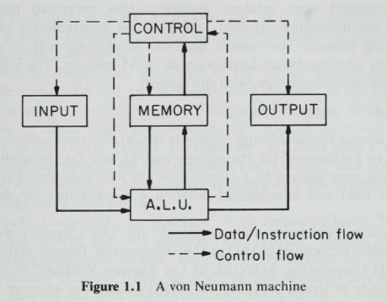
Input – incoming data & instructions:
keyboard
punched cards
network
Memory – stores instructions & data
CPU can extract & execute instructions
von Neumann bottleneck
  data & instructions via same bus
ALU (arithmetic logic unit)
execute
  calculations (+, -, etc)
  logic (AND, OR, etc)
  set of instructions, remember?
gets from memory
returns to
  memory
  output
J. Baer, Computer Systems Architecture, Computer Science Press, p. 5, 1980

Slide 10
Control unit – direct the flows
data
instructions
ensures instruction correct order
Output – sends result to the world
Monitor
Printer
Network
Every complex device:
Separate
  Control
  Processing
  Memory
  I/O
Flexible & general purpose
von Neumann bottleneck
J. Baer, Computer Systems Architecture, Computer Science Press, p. 5, 1980

Slide 11
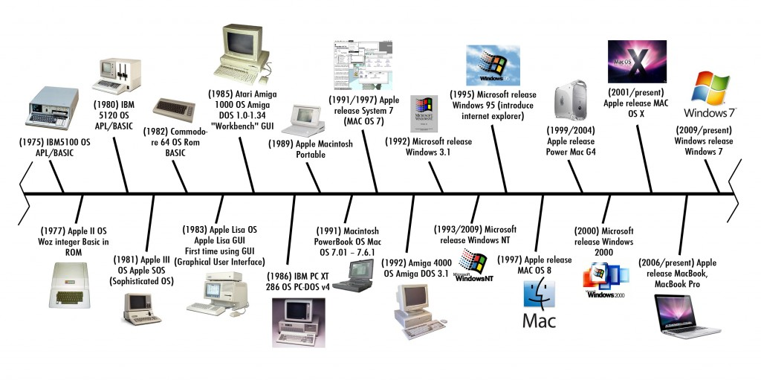
Ancestry.computer … for OS
Steve Jobs visits PARC
pre-1950s
no OS
full direct HW control
programs are loaded via
  switches
    mistake? start over
  punched cards
    progress!
1950s-1960s – batch processing
load data & programs
OS process them consequently
1960s-1970s – time-sharing
multiple programs in memory
switching in real-time
terminal access
Notes:
Homebrew Computer Club – Menlo Park CA --

Slide 12
Ancestry.computer … for OS
Steve Jobs visits PARC
1970s – Unix
Father of
  BSD-family
    FreeBSD
    OpenBSD
    NetBSD
    Etc
  Linux
  MacOS
    based on BSD
    => loved by devs
Notes:
Homebrew Computer Club – Menlo Park CA --

Slide 13
Ancestry.computer … for OS
Steve Jobs visits PARC
1980s
MS-DOS
  primitive
  singe-tasking
  simple to use => success
Mac OS
  GUI => wow!
  not the first, though
1990s
Windows 3.1 / 95 / 98 / NT
Mac OS is evolving
networks & internet
  NT / Linux - servers
Notes:
Homebrew Computer Club – Menlo Park CA --

Slide 14
Ancestry.computer … for OS
Steve Jobs visits PARC
2000s+ – mobile & embedded
iOS, Android, Blackberry, Win Phone
IoT devices
touch interfaces
constant connectivity
Ninja Turtles
2010s+ - cloud & virtualization
resources on-demand
serverless
k8s, Docker
orchestration & resource isolation
  before – on one computer
  now on scale
Notes:
Homebrew Computer Club – Menlo Park CA --

Slide 15
The evolution
Computers did not always look the way they do now
In fact they were once base-10, not base-2
  The original goal was just crunch numbers (math) very very fast
    e.g., Alan Turing’s Enigma project
EBCDIC was used instead of ASCII
The standard today, is binary, high density chips, multiprocessing
The future?
- Quantum Computing (https://www.ibm.com/quantum-computing/learn/what-is-quantum-computing)
- Neuromorphic Computing (R. A. Nawrocki, R. M. Voyles and S. E. Shaheen, "A Mini Review of
Neuromorphic Architectures and Implementations," in IEEE Transactions on Electron Devices, vol. 63, no. 10, pp. 3819-3829, Oct. 2016, doi: 10.1109/TED.2016.2598413)
Notes:
CDC 6600 – memory cost and why 60 bit words.

Slide 16
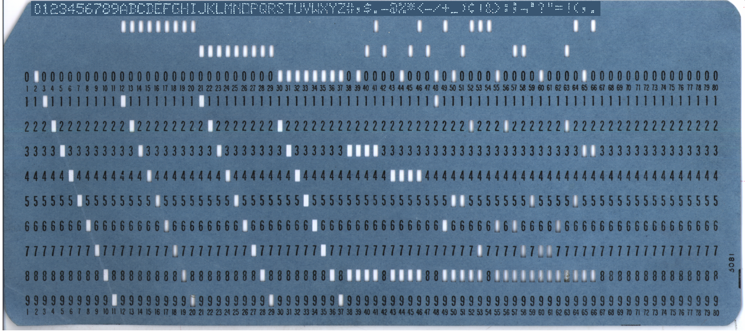
BCD – Binary Coded Decimal
80 characters
one per column
1 hole - number
2+ rows – letter / symbol
top rows
History of Punched Cards: https://homepage.divms.uiowa.edu/~jones/cards/codes.html

Slide 17
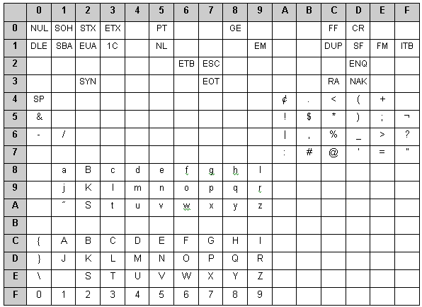
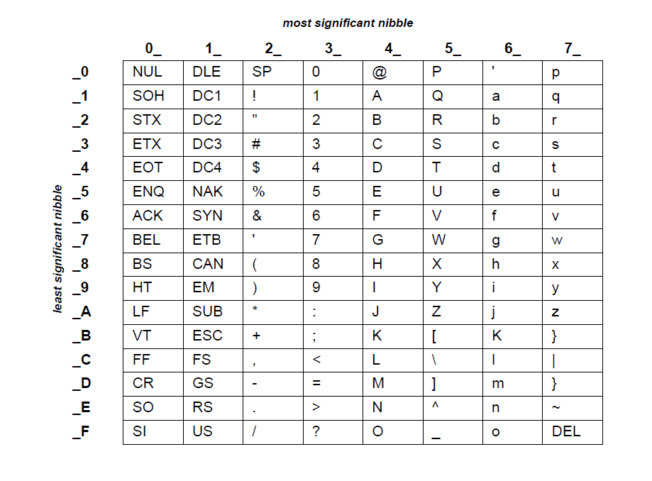
EBCDIC vs ASCII
Extended Binary Coded Decimal Interchange Code
1960s
Close holes in punched cards
  Can be misread
Values are scattered
  Letters are not sequential
  Hard to read & manipulate
Replaced by ASCII
Still in use
  legacy systems & data
    some mainframes
Professor: "So the American government went to IBM to come up with an encryption standard, and they came up with—"
Student: "EBCDIC!"
Notes:
Many incompatibilities; hard to use; Died with end of IBM mainframes.

Slide 18
But today: Your software on a computer … looks like this
Application
High level language
OS/ Drivers
Compiled libraries
Instruction Set
Binary
CPU
Memory
I/O
Translation to binary
&
contract between HW & software
=> compatibility issues
transistors
resistors
wiring
etc
Circuits/ Devices

Slide 19

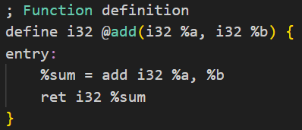
From code to CPU
8085 programming item | Description
Registers | These are 8 bit general purpose registers such as B,C,D,E,H,L as mentioned.
Accumulator | It is a 8 bit register used to store the result as well as intermediate operations of the mathematical operation.
Flags | These are five flags , set and reset according to certain arithmetic and logical conditions.
Program Counter(PC) | It is 16 bit in size. The microprocessor uses this register to sequence the executions of the instructions. It is also used as memory pointer. It holds memory address from where next byte is to be fetched. It basically points to the assembly codes stored in the form of opcodes. When a byte is fetched , PC is incremented by 1 to point to the next memory location.
Stack Pointer (SP) | It is 16 bit in size. It points to the memory location in R/W memory known as stack. The beginning of stack is defined by loading 16 bit address in the SP.
Compiler
  parse the code
  check the syntax
  produces an intermediate representation
  becomes
  optimization
    e.g., x = x * 2 -> x << 1
  translate optimized IR into assembly language

Slide 20
From code to CPU
8085 programming item | Description
Registers | These are 8 bit general purpose registers such as B,C,D,E,H,L as mentioned.
Accumulator | It is a 8 bit register used to store the result as well as intermediate operations of the mathematical operation.
Flags | These are five flags , set and reset according to certain arithmetic and logical conditions.
Program Counter(PC) | It is 16 bit in size. The microprocessor uses this register to sequence the executions of the instructions. It is also used as memory pointer. It holds memory address from where next byte is to be fetched. It basically points to the assembly codes stored in the form of opcodes. When a byte is fetched , PC is incremented by 1 to point to the next memory location.
Stack Pointer (SP) | It is 16 bit in size. It points to the memory location in R/W memory known as stack. The beginning of stack is defined by loading 16 bit address in the SP.
Assembler
  assembly -> machine codes (opcodes)
    e.g., mov eax, 5 -> B8 05 00 00 00
  some compilers skip assembly code
Linker
  combines object files into 1 executable
Instruction set
  assembly
  opcodes
  rules of translation
clang -mcpu=skylake main.c -o main

Slide 21
From code to CPU
8085 programming item | Description
Registers | These are 8 bit general purpose registers such as B,C,D,E,H,L as mentioned.
Accumulator | It is a 8 bit register used to store the result as well as intermediate operations of the mathematical operation.
Flags | These are five flags , set and reset according to certain arithmetic and logical conditions.
Program Counter(PC) | It is 16 bit in size. The microprocessor uses this register to sequence the executions of the instructions. It is also used as memory pointer. It holds memory address from where next byte is to be fetched. It basically points to the assembly codes stored in the form of opcodes. When a byte is fetched , PC is incremented by 1 to point to the next memory location.
Stack Pointer (SP) | It is 16 bit in size. It points to the memory location in R/W memory known as stack. The beginning of stack is defined by loading 16 bit address in the SP.
Execution cycle
  extract next instruction from memory
  decode an opcode
    what instruction
    what data
  execute the operation
  write the result
  jump to the next instruction
  3 GHz = 3 billion cycles / sec

Slide 22
From code to CPU
8085 programming item | Description
Registers | These are 8 bit general purpose registers such as B,C,D,E,H,L as mentioned.
Accumulator | It is a 8 bit register used to store the result as well as intermediate operations of the mathematical operation.
Flags | These are five flags , set and reset according to certain arithmetic and logical conditions.
Program Counter(PC) | It is 16 bit in size. The microprocessor uses this register to sequence the executions of the instructions. It is also used as memory pointer. It holds memory address from where next byte is to be fetched. It basically points to the assembly codes stored in the form of opcodes. When a byte is fetched , PC is incremented by 1 to point to the next memory location.
Stack Pointer (SP) | It is 16 bit in size. It points to the memory location in R/W memory known as stack. The beginning of stack is defined by loading 16 bit address in the SP.
1976 year – Intel 8085
Besides “execution units”:
  Registers – hold temporary data
  Accumulator – store arithmetic results
  Flags – zero, negative, overflow, etc
  Program counter – next instruction address
  Stack pointer – stack address
Now
  significantly more complex
  the same principles

Slide 23
From code to CPU
x86 examples
MVI D, 8CH <- load 0x8C to D
MVI C, 6EH <- load 0x6E to C
MOV A, C <- copy C (0x6E) to A
ADD D <- add D (0x8C) to A (0x6E)
OUT PORT1 <- send A (0xFA) to I/O
HLT <- stop
MVI A, 40H
RLC = A <- (A << 1)
RLC
RLC
OUT PORT1
HLT
What does this do?
What does this do?
Adds x8C and x6E = xFA (250)
Multiply by 8 (shift is x2)

Slide 24
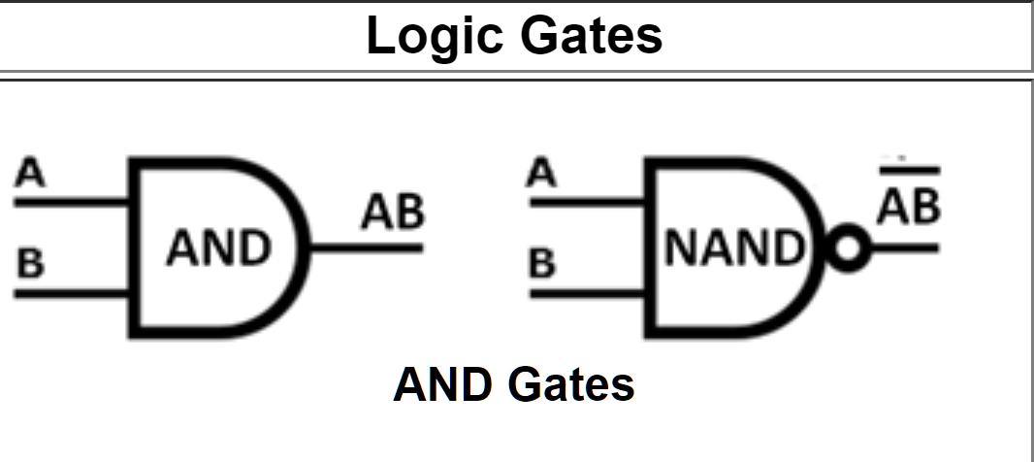
From there …
Not only arithmetics
CPU is not software, it’s circuitry
Consist of billion of transistors
  switches = 1 or 0
  cannot rewrite, have to combine
  digital (physical) logic
  logic gates built from transistors
    Input
      0 – low voltage
      1 – high voltage
    Output – determined by gate’s function
    No memory (well…)
What is a logic gate?
AND, NAND, OR, NOR, NOT, XOR …

Slide 25

Concept behind Logic … truth tables
 | A | B | AB | __ AB
Row1 | 0 | 0 | 0 | 1
Row2 | 0 | 1 | 0 | 1
Row3 | 1 | 0 | 0 | 1
Row4 | 1 | 1 | 1 | 0
What is the Software statement that corresponds to the logic gate diagram for output AB?
if (A && B) { …}
What is the Software statement that corresponds to the logic gate diagram for output
if ! (A && B) { …}

Slide 26
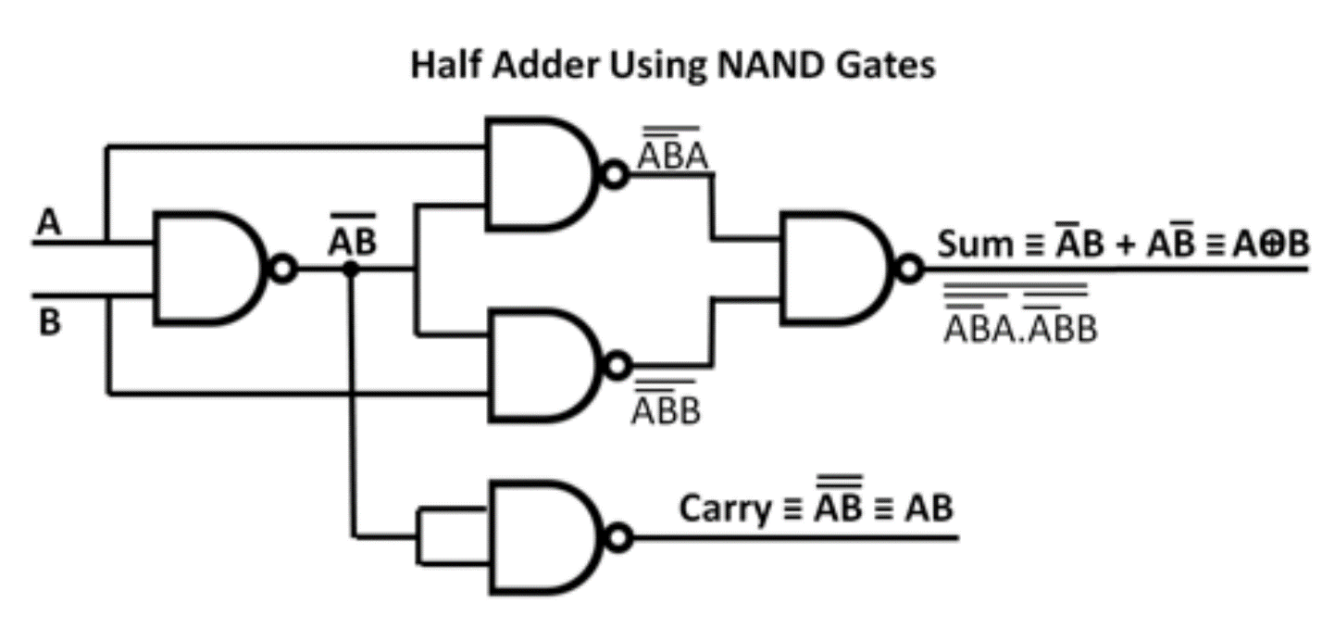
All math operations subset to digital logic
Subtraction is also addition in digital logic
Subtraction
To subtract binary number B (the subtrahend) from binary number A (the minuend).
  Add the 2's complement of B to A
  If there is a final carry bit, discard it and the result is positive.
  If B greater than A there will be no carry bit and the result will be the 2's complement of the sum and is negative.
Notes:
Half adder adds two single binary digits and provides a sum and carry value.

Slide 27



A simple ‘if’ statement
if (a == 0 and b != 0)
A
(MOSTLY CORRECT) ASSEMBLY CODE
&a = 0x5100; & b = 0x5200
LDA 0x5100
CMP 0
JZ SKIP
LDA 0x5200
JZ SKIP
BLAH, BLAH
SKIP: OTHER STUFF
B
Converted to digital logic, 2 logic gates
Roughly 8 transistors (2-5 per gate)
One simple line of code needs 8 transistors
Linux (just the kernel) has 10,000,000 lines of code

Slide 28
Reading material
Digital Logic:
https://mpoweruk.com/digital_logic.htm
Will be in quizzes (maybe on the exam)
Digital logic gates simulator:
https://www.kolls.net/gatesim/ (offline)
https://academo.org/demos/logic-gate-simulator/ (online)

Slide 29
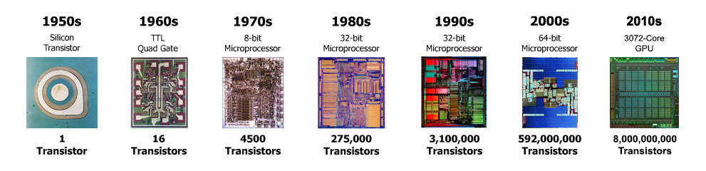
And this is why Moore’s law is important!
The number of transistors on an integrated circuit doubles approximately every 2 years.
Not fully correct now due to physical limitations.
Always know your history so you can build the future

Slide 30
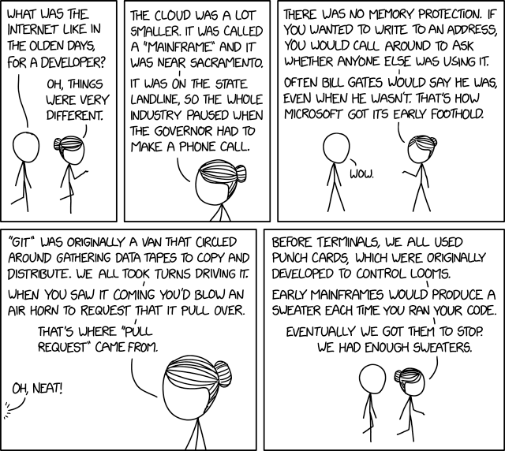
https://xkcd.com/2324/

